Slide 1
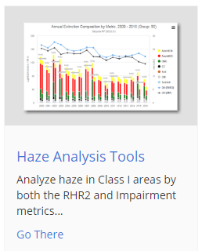
Regional Haze Planning Work Group
Progress Report #1
Technical Support System (TSS) v.2
October 5, 2018

Slide 2
Today’s questions (with answers!)
Why are there different databases? What do they have in common?
What is the TSS?
Types of information – now and in the future
Tool development – specifically designed for RH planners
How do we get there? How do we use it?
What tools have been developed so far?
What’s the plan for the future?
What’s the best way to be kept in the loop?

Slide 3
Why are there different databases? What do they have in common?
The CIRA Air Quality System

Slide 4
CIRA Air Quality System Overview
Database
Web
Software
Hardware
Monitoring Datasets:
IMPROVE (and special studies)
IMPROVE RHR and Impairment
AQS (Almost every dataset)
CASTNET (Dry deposition, O₃)
NADP (NTN, AIRMoN, MDN, Derived)
USFS Water Quality
more…
Websites:
WRAP TSS
IWDW
IMPROVE
FED
NPSCAT
SEMAP
VIEWS
CIRA Air Quality System
Physical Infrastructure:
Fifteen Windows servers
Three 8U Linux file servers
Onsite sys-admin and service
99.9% Internet up-time
University-sized fiber optic Internet “pipe”
Internal data throughput of +1000 GB/s
Specialized Tools:
ESRI ArcGIS
Interactive Data Language (IDL)
Statistical Analysis System (SAS)
MATLAB
Mathematica
ENVI

Slide 5
WRAP
Technical Support System
(TSSv2)
Partners: WRAP States, WESTAR
Intermountain West
Data Warehouse
(IWDW)
Partners: NPS, BLM, USFS, EPA, CO, WY, UT, NM
Databases
Web
Software
Hardware
CIRA Air Quality System
Federal Land Manager
Environmental Database
(FED)
Partners: NPS, USFS
Southeastern
Modeling, Analysis, and Planning System
(SEMAP)
Partners: EPA, AL, FL, GA, KY, MS, NC, SC, TN

Slide 6
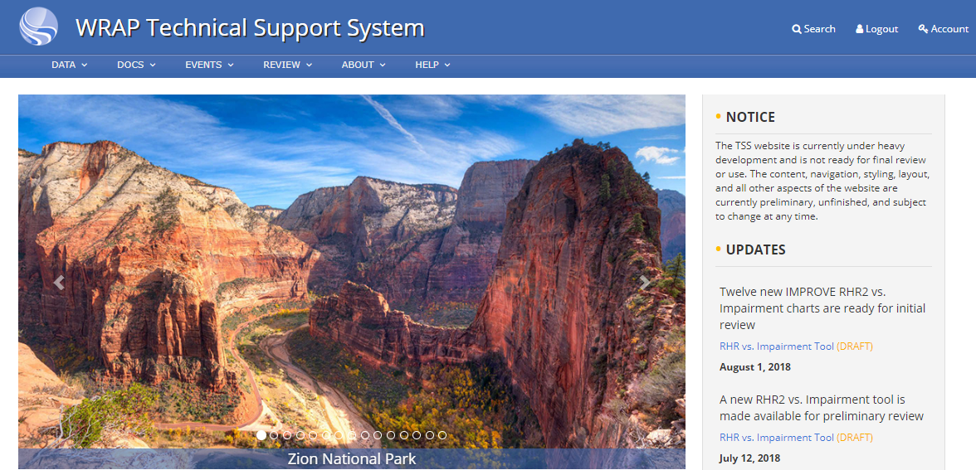
What is the TSS?
The new “Technical Support System” (TSS v2) – a web-based application being developed by CIRA collaborators
Monitoring data and visualization tool (in process)
Emissions data and visualization tool (future)
Modeling data and visualization tool (future)
Query wizard (future)
The goal is that it will be the “one-stop shop” for your Regional Haze / Visibility Protection planning needs

Slide 7
It’s time for a demonstration. Take it away, Shawn and Ted!

Slide 8
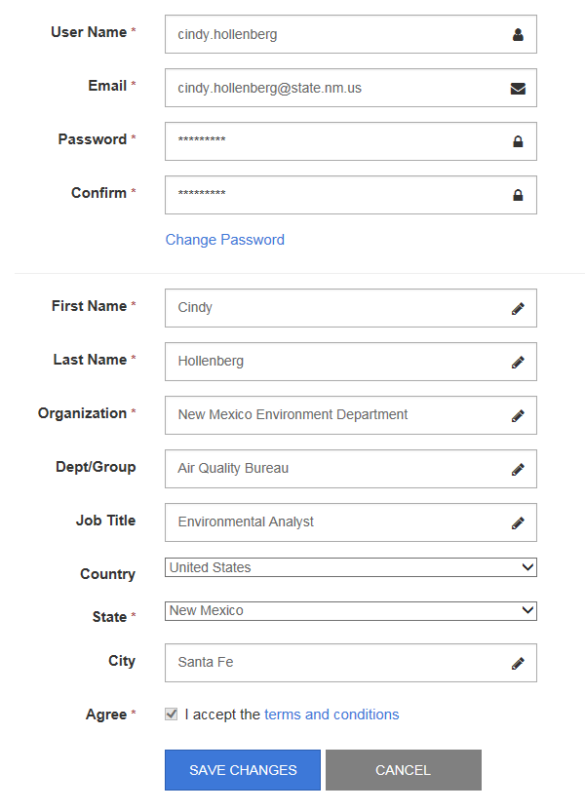
How do we get there? How do we use it?
The TSS v2 requires that users register before use.
http://views.cira.colostate.edu/tssv2/Auth/Register.aspx
Once registered, you’ll either be directed to the TSS v2, or you may follow the following link:
http://views.cira.colostate.edu/tssv2/

Slide 9
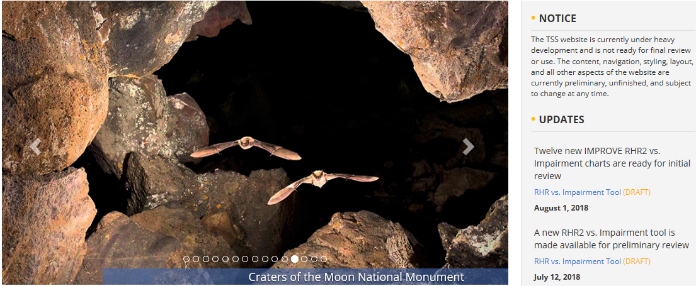
Pay attention to this notice!
Updates appear here – visit often!

Slide 10
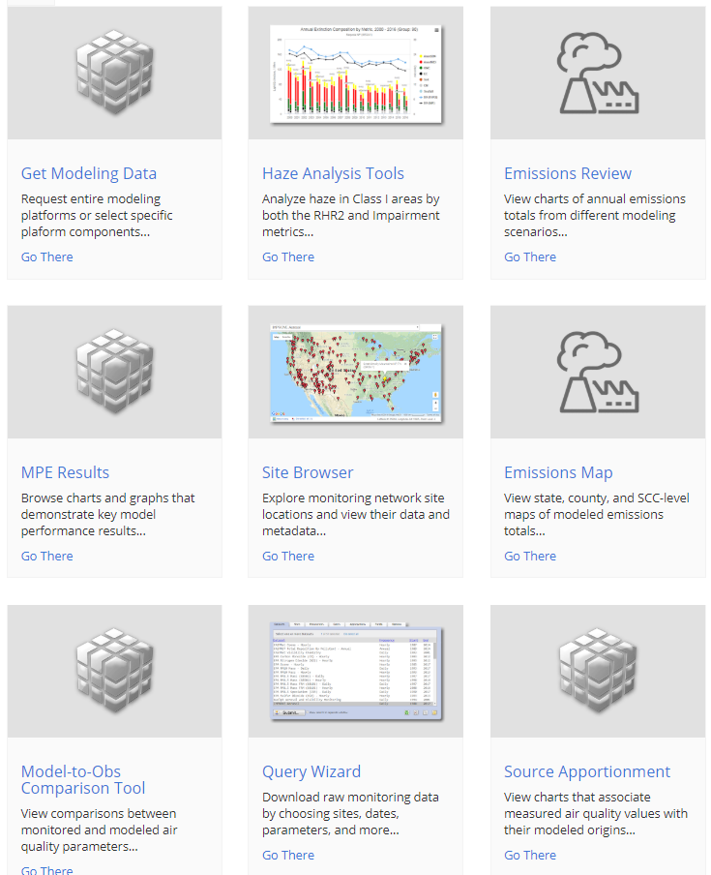
What tools have been developed so far? What’s the plan for the future?

Slide 11
What’s the best way to be kept in the loop?
The Regional Haze Planning Work Group has five subcommittees:
Monitoring / Glide Path
Emissions Inventory / Modeling
Control Measures
Shared Database
Consultation & Coordination
These 5 subcommittees are all doing fantastic work, but right now, only a few states participate.
Get involved!

Slide 12
Contact information for Regional Haze Planning
Regional Haze Planning Work Group co-chairs:
Tina Suarez-Murias (CA)
christine.suarez-murias@arb.ca.gov
Jay Baker (UT)
jbaker@utah.gov
WRAP Technical Specialist
Tom Moore
tmoore@westar.org
National Parks Service/Consult Coordinator
Pat Brewer
patricia_f_brewer@nps.gov
Find more information at:
https://www.wrapair2.org/RHPWG.aspx
Monitoring / Glide Path SC:
Ryan Templeton (AZ)
Templeton.Ryan@azdeq.gov
EI / Modeling SC:
Farren Herron-Thorpe
farren.herron-thorpe@ecy.wa.gov
Control Measures SC:
Curt Taipale (CO)
curtis.taipale@state.co.us
Shared Database SC:
Cindy Hollenberg (NM)
cindy.hollenberg@state.nm.us
Consultation & Coordination SC:
Rebecca Harbage (MT)
rharbage@mt.gov

Slide 13
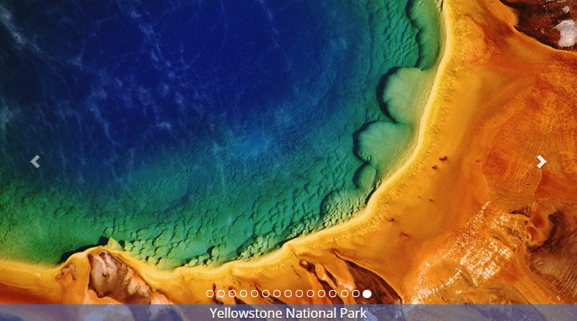
Questions?
Thank you!

